Slide 1

IS POPULATION GROWTH A KEY DRIVER OF ECONOMIC GROWTH?
Team members:
Oliver King
Ufuoma Atakere

Slide 2

Overview
Project objectives
Database applications
Dataset used:
Criteria for country’s inclusion
Population > 500,000
30years of data available (1990-2019)
Lessons learned / Conclusion
Programming languages used:
World bank Data
Flask
Python
PostgreSQL
JavaScript/Html
149 countries included

Slide 3

Project Objectives
We propose to analyze the long-term relationship between a range of countries’ population growth rates and their economic growth rates to determine whether there is a statistically significant relationship.
We will break down population growth into its key drivers
Net migration
Natural birth rate
Longevity (aka. life expectancy)
We will determine whether any of these key drivers have a statistically significant relationship with a country’s economic growth rate.

Slide 4
Notes on Dataset:
We have chosen to analyse data to 2019 for two key reasons:
Including 2020 data would have reduced the number of countries that met our study’s criteria (as more countries would have null entries for certain fields);
The impact of covid on both GDP and net-migration was dramatic. By excluding 2020 data we’re likely to get a more reliable approximation of population growth’s effect on GDP growth.

Slide 5
What we did
Notes:
We sourced data from different websites but ended up with world bank database.
We scrotinized and cleaned the data with python and concluded with the data
Python Flask-powered API was used during the data gathering process.
PostgreSQL database was used to store and retrieve data using PgAdmin.
We used HTML/CSS and JavaScript for data visualisations and the charts.

Slide 6
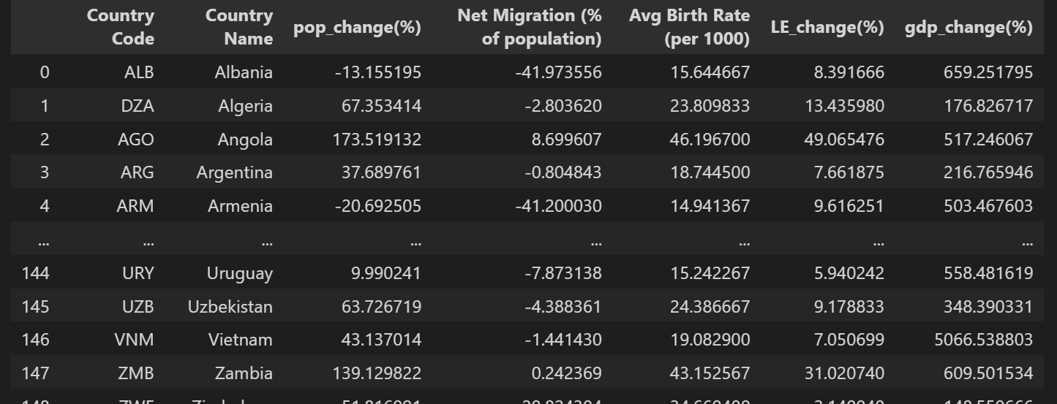
Python
Imported data into Pandas Notebook from multiple World Bank CSV’s.
Loaded data into data frames.
Edited contents of data frames to:
1. Exclude entries will null values;
2. Exclude countries with population < 500,000;
3. Drop unneeded columns;
Exported final data to a CSV.

Slide 7
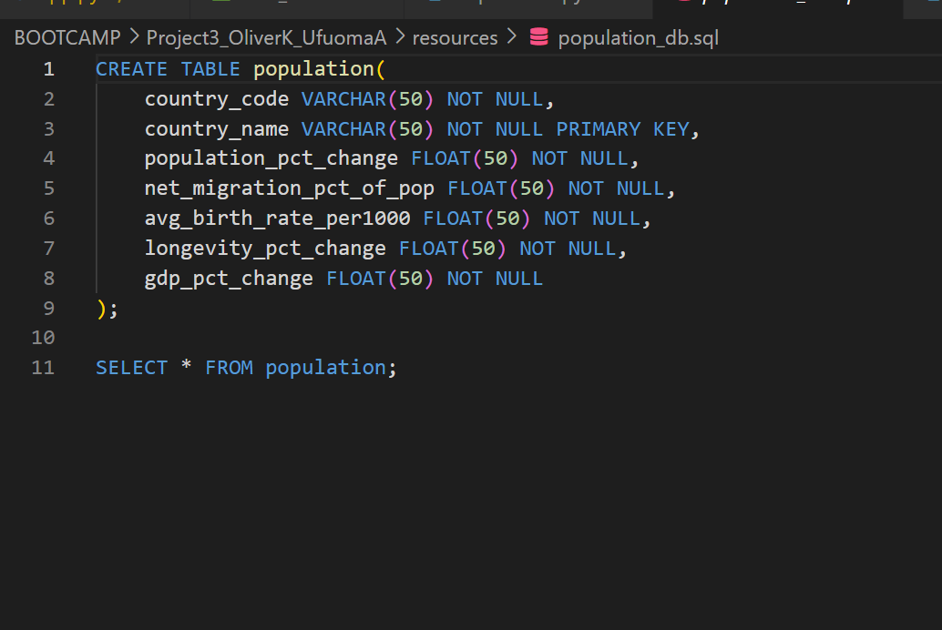
postgresSQL
Using PgAdmin
Create a database and a table with necessary columns and loaded in the CSV.

Slide 8
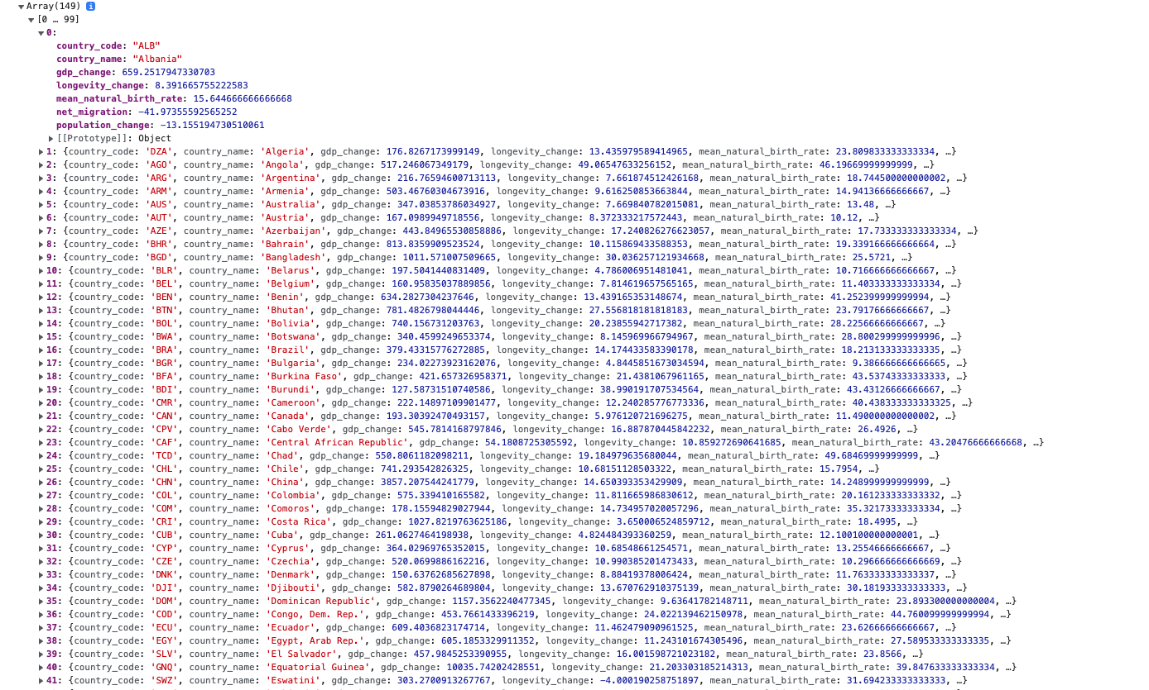
FLASK
Flask was used to read the data from the database and convert it to a list of dictionaries in JSON format.
Flask enabled the dataset to be viewed in a browser window.

Slide 9
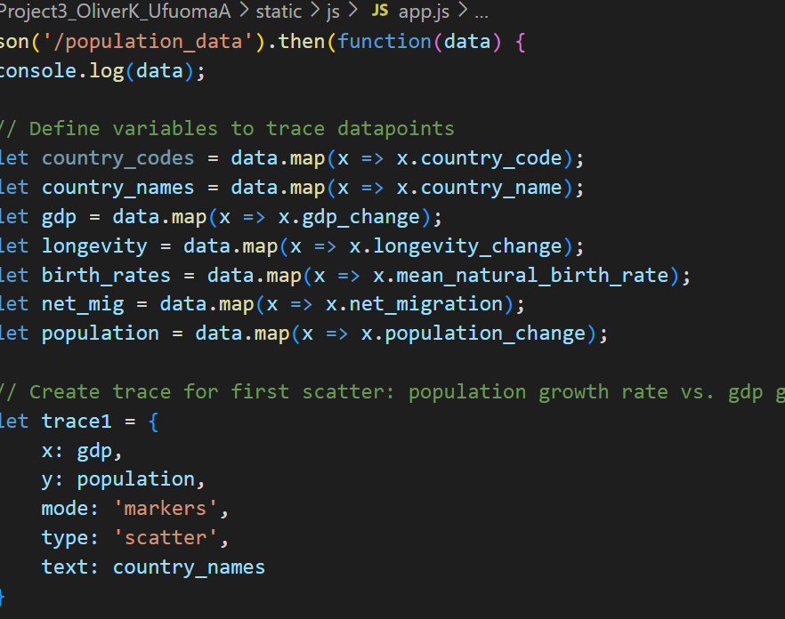
JavaScript & HTML
Was used to create scatter plot visualisations and with a dynamic mouse-over function.
The datapoints required for the visualisations were traced using a “.map()” function.
Correlations were calculated to display each factor’s ability to “explain” GDP growth.
An ”onchange” event was used update the Information Table when a user selects from the dropdown list.

Slide 10
Conclusion
Takeaways:
Overall, population growth has a relatively low correlation with economic growth.
This might imply that population growth is not necessary for a country to produce strong GDP growth.
Population growth is more highly correlated with GDP growth than any of its individual subfactors.
Of the subfactors, net migration has the highest correlation.
All of the correlations are positive.
This might imply that, overall, all factors have a positive impact on GDP growth.
Factor | Correlation
Population Growth | 0.26
Net Migration¹ | 0.22
Natural Birth-rate¹ | 0.08
Longevity (Life-expectancy)¹ | 0.11
1. Denotes a subfactor of Population Growth

Slide 11

Thank you

